Slide 1
Annotated Lecture Slides for Sugar and Salt Solutions
AUTHORS:
Yuen-ying Carpenter (University of Colorado Boulder)
Trish Loeblein (University of Colorado Boulder)
COURSE:
Introductory Chemistry
COPYRIGHT: This work is licensed under a Creative Commons Attribution 4.0 International License.

Slide 2
Learning Goals
Explain the difference between the conductivity of solutions of ionic and molecular compounds based on the presence or absence of freely moving charged particles
Describe the atomic-level structural features of ionic compounds
Describe the forces involved in ionic bonding
Identify if solutions contain ionic or molecular compounds based on conductivity
Identify if solutions contain ionic or molecular compounds based on atomic-scale representations
Describe the bonding in ionic compounds of polyatomic ions
Determine if a chemical compound is best described as ionic or molecular based on its chemical composition, specifically whether it contains metal and non-metal elements or not

Slide 3
Matter
Pure substances
Elements
Compounds
Mixtures
Homogeneous
Heterogeneous
?
?
How can we distinguish between different types of compounds?
Notes:
Outline – Connection to previous course content
The previous class topic included the classification of compounds into the categories shown here – this material extends classification to types of compounds

Slide 4
How does the atomic-level structure of compounds affect their observable properties?
Conductivity
in solution
Types of
chemical bonds
How can we use the periodic table to predict the bonding and properties of compounds?
Notes:
Outline - Key questions we will be seeking to answer in these next two lectures

Slide 5
Beaker Contents | Observations
Water
Water + Salt
Water + Sugar
Notes:
(optional) Blank slide for in-class annotation of Sim demonstration – Macro tab
** See next slide and facilitation guide for sim demo details and faciliation tips **

Slide 6
Beaker Contents | Observations
Water | No conductivity (lightbulb does not light)
Water + Salt | Lightbulb lights up. More salt added = brighter bulb. Solid salt by itself does not conduct.
Water + Sugar | No conductivity (lightbulb does not light)
Notes:
Summary slide of class observations from Sim demonstration – Macro tab
Key features of sim demo (concentration graph closed):
Start by orienting students to features, including water faucets (so that they are aware that water can be added or the beaker contents drained)
Place the conductivity meter in solution and experiment with different solutions, making sure to test water by itself before adding any solutes
Prompt students to suggest ways of making the light brighter or dimmer once solutes are added
Try mixing solutes
Make sure to highlight that solid salt is not conductive, possibly by placing the conductivity meter at the very bottom of the container, and then evaporating a salt solution to dryness
** See facilitation guide for additional sim demo faciliation tips **

Slide 7
Why do these solutions have different conductivity?
What is different about dissolving salt vs. sugar in water?

Slide 8
Conductivity
For a substance or mixture to conduct electricity…
It must contain charged particles
Charged particles must be free to move or migrate
But we know both salt and water have no overall charge, separately….
Notes:
Explain properties needed for conductivity, as a lead in to seeing what students might propose as models that explain the conductivity of salt solutions
Key facilitation questions and discussion ideas:
How can salt solutions conduct electricity? Salt doesn’t have any overall charge, and neither does water, so what’s happening to produce charged particles when it dissolves in water?
What kinds of charged particles have we studied in class already? Students have recently studied the subatomic particles that make up the atom, so student suggestions included: Electrons; Protons, Ions (positive and negative – cations and anions)

Slide 9
When salt (NaCl) dissolves in water, …
 | it will produce… | Because…
A | [NaCl]⁺ molecules | It transfers electrons to the water.
B | Na⁺ and Cl– ions | Electrons are transferred from Na atoms to Cl atoms
C | Na⁺ and Cl– ions | The ions in the salt separate
D | H⁺ and OH– ions | It forces water to break into H⁺ and OH⁻ ions
E | More than one of the above
Notes:
Sim directions: Prior to this question, demonstrate the difference in conductivity between solid salt and salt dissolved in water using the sim and discuss conductivity requiring freely moving charged particles
Goal: Get students to commit to a prediction and determine prior conceptions of the origin of charged particles when salt dissolves
Correct answer: C
Representative results from pre-general chemistry (when used prior to instruction): Roughly evenly distributed answers across all options except D.
Follow-up discussion: Use the ‘Water’ tab of the simulation to look at salt before and after it dissolves in water. Emphasize that the ions are already present in the solid salt, and that the ions dissociate in water.

Slide 10
What’s happening at the atomic level?
Beaker Contents | Observations
Water + Salt | Before | After
Water + Sugar | Before | After
Notes:
(optional) Blank slide for in-class annotation of Sim demonstration – Water Tab
** See next slide and facilitation guide for sim demo details and faciliation tips **

Slide 11
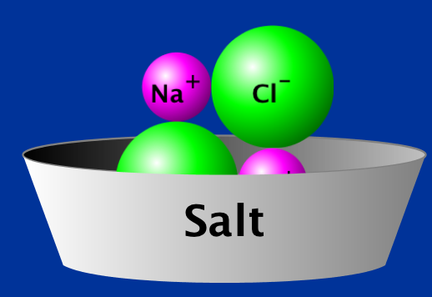
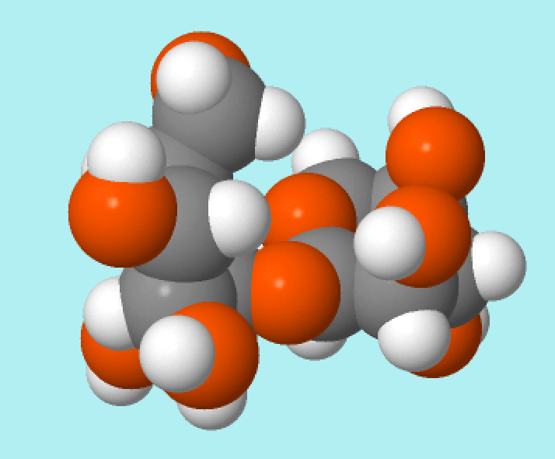
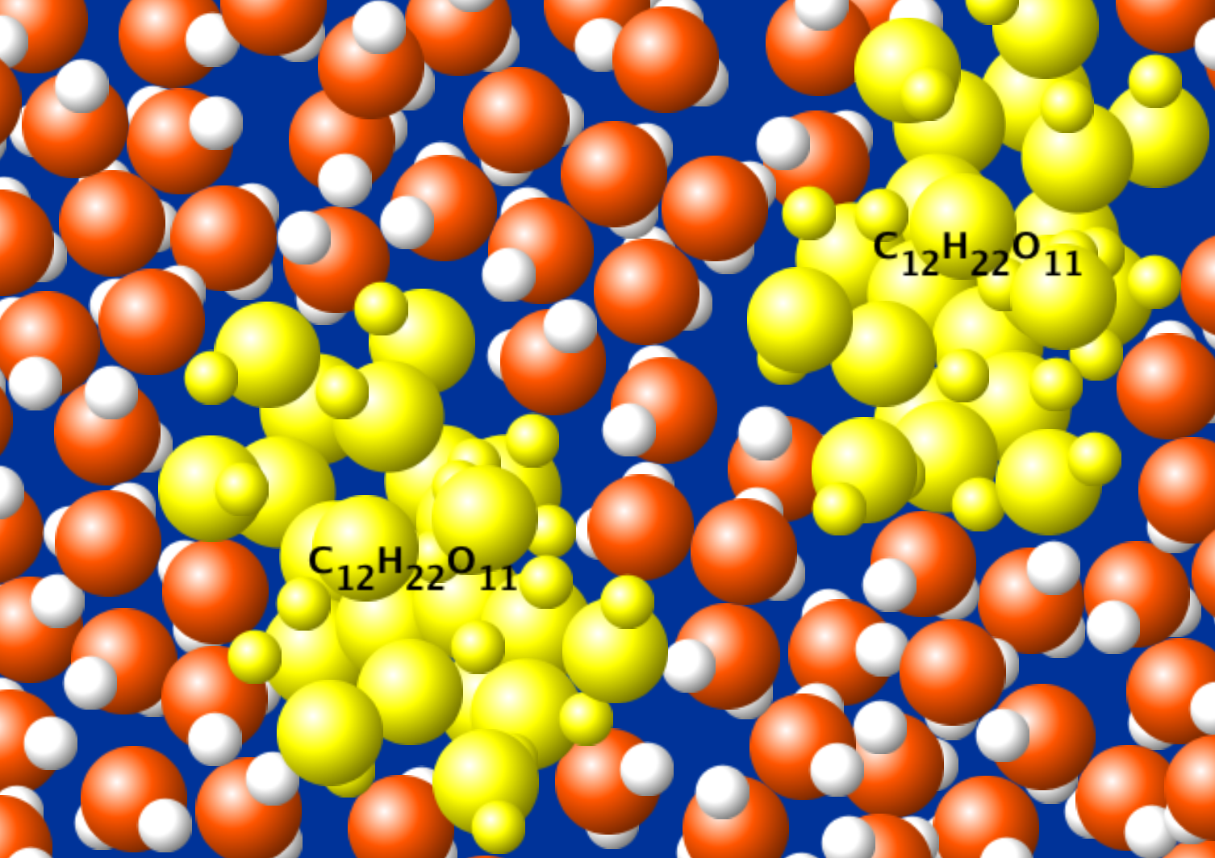
What’s happening at the atomic level?
Beaker Contents | Observations
Water + Salt | Before | After
Water + Sugar
- Ions
- Multiple repeating units
- No charges
- No charges
- Same structure (highlighted in yellow for visibility)
Notes:
Summary of class observations from Sim demonstration – Water Tab
Use the 3rd tab of the simulation to show an atomic scale model of salt and sugar before and after dissolving in water, highlighting the structural features listed above, especially the charges and repeat units in solid sodium chloride. Note that you will likely have to repeat the demo more than once to highlight all features. Be sure to show glucose both with and without highlighting, showing that it is composed of many atoms, but these are difficult to tell apart from water without highlighting.
** See facilitation guide for additional sim demo faciliation tips **

Slide 12
Ionic Compound Example
NaCl(s) → Na⁺(aq) + Cl⁻ (aq)
Key features of ionic solid:
Repeated units in larger lattice
Units are made of charged ions
Notes:
Summarize the observations for dissociation of an ionic compound
Key facilitation notes:
Remember to add that (aq) stands for aqueous, i.e. dissolved in water, especially if this notation or phase is new to students
Emphasize the repeat units AND the ratio for net neutral charge
Emphasize that NaCl still consists of ions even when written as NaCl(s) – this condensed formula contains embedded information

Slide 13
Ionic Bonding
A type of chemical bond due to the attractive electrostatic force between cations and anions.
Electrostatic forces: attraction/repulsion that exists between charged particles.
-
-
+
+
-
+
Notes:
Key facilitation points:
Discuss attraction + repulsion between opposite vs. same charge particles
Talk about the bond between ions resulting from attraction
Highlight that one positive ion is not limited to attracting a single negative ion! This is why we see the repeating lattice of ionic salts.

Slide 14
Sodium chloride is solid at room temperature: NaCl_{(s)}
Will melted sodium chloride NaCl_{(l)} conduct electricity?
Yes
No
It depends
Notes:
Goal: Relate the description of conductivity to a context outside of the simulation. Note that this question is mostly intended to spark discussion and remind students of the features needed for conductivity, in order to lead into definitions of electrolytes
Correct answer: A
Representative results from pre-general chemistry: 45% A and 39% B when first asked
Follow-up discussion: Students asked if the ions dissociate from each other when sodium chloride melts. We then reviewed the requirements for a material to be conductive, and students were re-polled.
Representative results from pre-general chemistry on second polling: 62% A and 30% B

Slide 15
Electrolyte | Non-electrolyte
Notes:
(optional) Blank slide for in-class annotation

Slide 16
Electrolyte | Non-electrolyte
Conducts electricity | Does not conduct electricity
Release ions when dissolved in water (Dissociation OR ionization) | No mobile or dissociated ions
ionic compounds are always electrolytes
(if they dissolve in water).
Notes:
Goal: Introduction to new terminology: distinctions between electrolytes and non-electrolytes
Additional faciilitation points:
Most molecular compounds are nonelectrolytes (could use this to lead into discussions of acids and bases in future!)

Slide 17
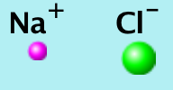
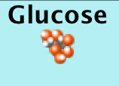
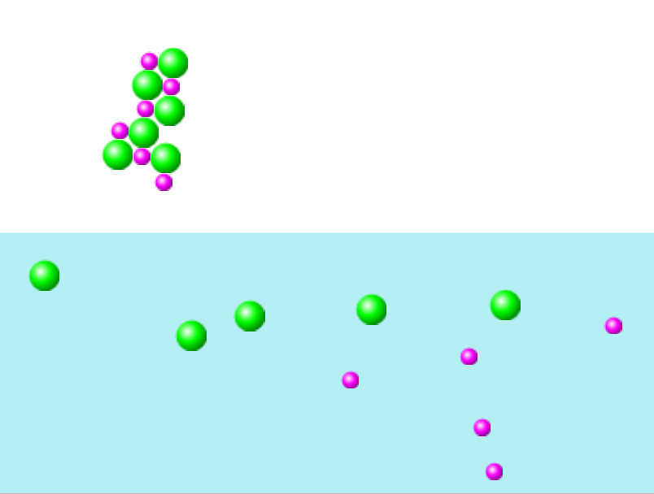
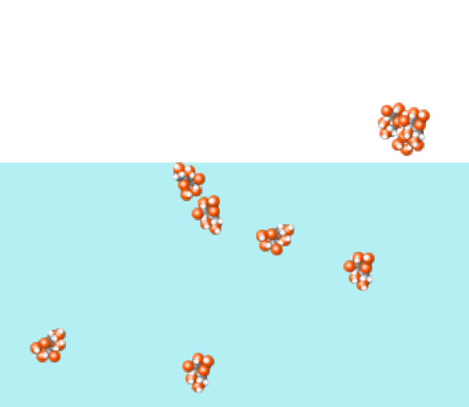
Which box shows an electrolyte dissolving in water?
K
+
1.
2.
a. Box 1 b. Box 2 c. Both d. Neither
Notes:
Note: The image on the left is actually NaCl dissolving in the simulation, but the ion sizes are still roughly appropriate, so this allowed students to extend to another ionic solid beyond the NaCl example already discussed.
Correct answer: A
Representative results from pre-general chemistry: 91% correct
Follow-up discussion: Students were asked to explain what features they used in the pictures to decide on their answer; focus on the before and after, and the presence or absence of charged particles

Slide 18
Molecular Compound Example
Discrete units
Atoms held together by covalent bonds
Usually do not dissociate in water
Figure 3.7
Sucrose, C₁₂H₂₂O₁₁
Notes:
Contrast previous descriptions of properties of ionic compounds with properties of molecular species; lead into next slide describing covalent bonds

Slide 19
Covalent Bonding
Chemical bonds due to the sharing of electrons by two (or more) atoms
Copyrighted textbook graphic omitted.
Description:
Graph depicting lower energy state of covalently bonded H₂ molecule compared to H atoms separated by a large distance
Notes:
Facilitation note:
If desired, can highlight that electrostatic forces are involved in covalent bonds too, in terms of nuclei mutually attracting electrons, but this is not necessary

Slide 20
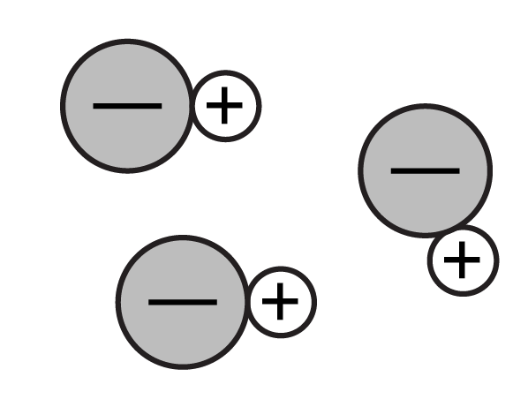
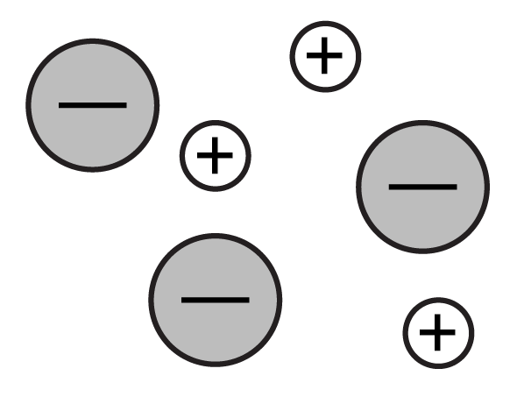
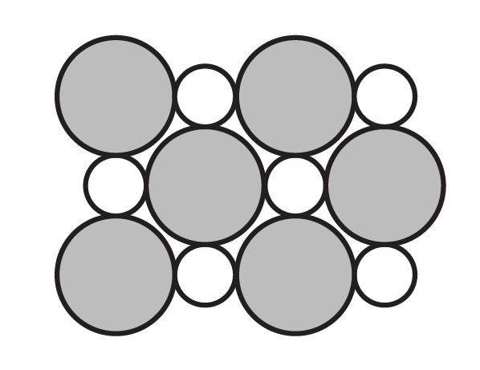
How many of these pictures correctly depict the all of the features of solid NaCl?
a. Zero b. 1 c. 2 d. 3
Notes:
Note: This concept question was originally intended as a review question, opening the 2nd lecture on this topic, however, it could equally be used mid-class.
Goal: Highlight that ionic solids are not molecular in structure (but form lattices) and that they contain charged ions even before they dissociate in water. Relate this back to the observed pre-dissolution and post-dissociation sim images.
Correct answer: A
See next slide for follow-up discussion

Slide 21
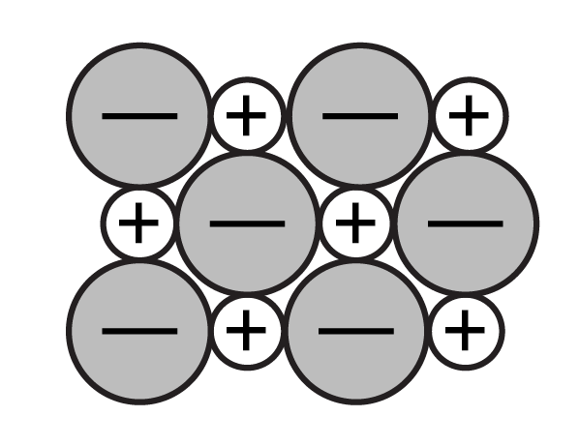
A correct (and complete) 2D representation of solid NaCl.
How many of these pictures correctly depict the all of the features of solid NaCl?
Incorrect – solid NaCl doesn’t form discrete molecules.
Incorrect – solid NaCl does not dissociate (until we dissolve it in water)
Incorrect, unless we define the circles as ions – solid NaCl does form an extended lattice like this, but it is made of charged ions even when it’s a solid.
a. Zero b. 1 c. 2 d. 3
Notes:
Follow-up discussion: During this discussion, use the 3rd (water) tab of sugar and salt solutions to highlight the structure of solid NaCl. Note that the diagram at the far right may have some ambiguity, since it is not explicitly stated that these do not represent charged ions. Most of the annotations in red are not shown in class, just discussed.

Slide 22
Matter
Pure substances
Elements
Compounds
Mixtures
Homogeneous
Heterogeneous
Molecular
Ionic
Notes:
Outline – Connection to previous course content
The previous class topic included the classification of compounds into the categories shown here – this material extends classification to types of compounds

Slide 23
Chemical Name | Chemical Formula | Electrolyte? | Type of bonding
Sodium chloride | NaCl
Sucrose | C₁₂H₂₂O₁₁
Calcium chloride | CaCl₂
Glucose | C₆H₁₂O₆
Sodium nitrate | NaNO₃
Notes:
(optional) Blank slide for in-class annotation during Sim demonstration - Micro tab
Sim demo: For each substance, show the substance dissolving in water, and ask students if it will conduct electricity, and the type of bonding in the compound.

Slide 24
Chemical Name | Chemical Formula | Electrolyte? | Type of bonding
Sodium chloride | NaCl | Yes | Ionic
Sucrose | C₁₂H₂₂O₁₁ | No | Covalent
Calcium chloride | CaCl₂ | Yes | Ionic (note that more ions means higher conductivity per formula unit vs. NaCl)
Glucose | C₆H₁₂O₆ | No | Covalent
Sodium nitrate | NaNO₃
Notes:
Summary of observations from demo thus far.
Optional additional facilitation idea:
Highlight that there are more dissolved ions in solution in the case of CaCl₂ per unit added. Ask students to recall what happened when more sodium chloride was added in the first demo, and connect this to the predicted conductivity of equal units of CaCl₂ vs NaCl

Slide 25
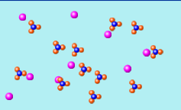
What kind of bonding is in this compound before it goes into the water?
a. Ionic b. Covalent c. Both d. Neither
Notes:
Goal: Relate the type of bonding in a compound to the dissociation or lack thereof of the atoms/ions in the compound
Correct answer: C
Representative results from pre-general chemistry: 69% correct (20% B and 11% A) when used in this context
Follow-up discussion: Students were asked to explain what features they used in the pictures to decide on their answer and this was used to introduce the topic of polyatomic ions in class

Slide 26
Chemical Name | Chemical Formula | Electrolyte? | Type of bonding
Sodium chloride | NaCl | Yes | Ionic
Sucrose | C₁₂H₂₂O₁₁ | No | Covalent
Calcium chloride | CaCl₂ | Yes | Ionic (note that more ions means higher conductivity per formula unit vs. NaCl)
Glucose | C₆H₁₂O₆ | No | Covalent
Sodium nitrate | NaNO₃ | Yes | Ionic (between Na⁺ and NO₃–) and Covalent (within the polyatomic ion NO₃–)
Notes:
Summary
Observations of sodium nitrate added to the chart, and used to introduce the idea of polyatomic ions (next slide)

Slide 27
Polyatomic Ions
Polyatomic ion
A group of covalently bonded atoms with an overall net charge
Oxoanions
A common class of polyatomic ion that contains oxygen and another element
Copyrighted textbook graphic omitted
Description:
Depictions of other common polyatomic ions, to expand on the example of a nitrate anion shown in the simulation

Slide 28
Ionic compounds | vs | Molecular compounds
ionic Results from attraction of positive and negative ions | Type of Bonding | covalent Results from sharing of electrons between atoms
Notes:
Sequential summary slide comparing properties of ionic and molecular compounds (1 of 5)

Slide 29
Ionic compounds | vs | Molecular compounds
ionic Results from attraction of positive and negative ions | Type of Bonding | covalent Results from sharing of electrons between atoms
Always dissociates (ionizes) Always an electrolyte | Behavior in water | Usually does not dissociate *exception: ACIDS & BASES
Notes:
Sequential summary slide comparing properties of ionic and molecular compounds (2 of 5)

Slide 30
Ionic compounds | vs | Molecular compounds
ionic Results from attraction of positive and negative ions | Type of Bonding | covalent Results from sharing of electrons between atoms
Always dissociates (ionizes) Always an electrolyte | Behavior in water | Usually does not dissociate *exception: ACIDS & BASES
Repeating units | Structure | Discrete entities
Notes:
Sequential summary slide comparing properties of ionic and molecular compounds (3 of 5)

Slide 31
Ionic compounds | vs | Molecular compounds
ionic Results from attraction of positive and negative ions | Type of Bonding | covalent Results from sharing of electrons between atoms
Always dissociates (ionizes) Always an electrolyte | Behavior in water | Usually does not dissociate *exception: ACIDS & BASES
Repeating units | Structure | Discrete entities
Formula unit Represents the smallest whole number ratio of elements | Chemical formula | Molecular formula Represents the actual number of atoms in each discrete molecule
Notes:
Sequential summary slide comparing properties of ionic and molecular compounds (4 of 5)

Slide 32
How does the atomic-level structure of compounds affect their observable properties?
Conductivity
in solution
Types of
chemical bonds
How can we use the periodic table to predict the bonding and properties of compounds?
Notes:
RECALL: We have answered the top question, but have yet to discuss the 2nd question

Slide 33
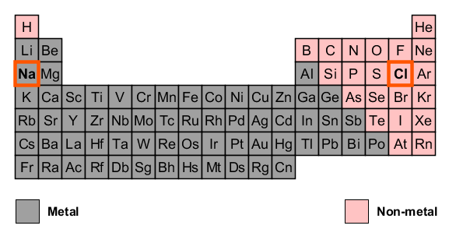
Notes:
Introduce classification of elements into metal and non-metal using the Periodic table from the simulation highlighting metals vs. non-metals.
Note that metalloids are not distinguished, but none of the compounds in the simulation (or typically of introductory chemistry) fall in this category.

Slide 34
Metals, Nonmetals, and Metalloids
Metals:
Characteristic luster (shiny!).
Good conductors of heat and electricity.
Solid at room temperature, except mercury.
Nonmetals:
Dull in appearance.
Poor conductors of heat and electricity.
Metalloids:
Possess some metallic and some non-metallic properties (sometimes depends on the situation!)

Slide 35
Chemical Name | Chemical Formula | Electrolyte? | Type of bonding | Component elements
Sodium chloride | NaCl |  |  | ☐ Metal ☐ Non-metal
Sucrose | C₁₂H₂₂O₁₁ |  |  | ☐ Metal ☐ Non-metal
Calcium chloride | CaCl₂ |  |  | ☐ Metal ☐ Non-metal
Glucose | C₆H₁₂O₆ |  |  | ☐ Metal ☐ Non-metal
Sodium nitrate | NaNO₃ |  |  | ☐ Metal ☐ Non-metal
Notes:
(optional) Alternate Blank slide for in-class annotation during Sim demonstration - Micro tab
This slide also includes the final column regarding component elements, so you could compare all properties at the outset.

Slide 36
Chemical Name | Chemical Formula | Electrolyte? | Type of bonding | Component elements
Sodium chloride | NaCl | Yes | Ionic | ☑ Metal ☑ Non-metal
Sucrose | C₁₂H₂₂O₁₁ | No | Covalent | ☐ Metal ☑ Non-metal
Calcium chloride | CaCl₂ | Yes | Ionic (note that more ions means higher conductivity per formula unit vs. NaCl) | ☑ Metal ☑ Non-metal
Glucose | C₆H₁₂O₆ | No | Covalent | ☐ Metal ☑ Non-metal
Sodium nitrate | NaNO₃ | Yes | Ionic (between Na⁺ and NO₃–) and Covalent (within the polyatomic ion NO₃–) | ☑ Metal ☑ Non-metal
Notes:
Final summary chart of compounds in simulation, including the metal/non-metal nature of the elements

Slide 37
Ionic compounds | vs | Molecular compounds
ionic Results from attraction of positive and negative ions | Type of Bonding | covalent Results from sharing of electrons between atoms
Always dissociates (ionizes) Always an electrolyte | Behavior in water | Usually does not dissociate *exception: ACIDS & BASES
Repeating units | Structure | Discrete entities
Formula unit Represents the smallest whole number ratio of elements | Chemical formula | Molecular formula Represents the actual number of atoms in each discrete molecule
metals + non-metals together | Elements involved | Only non-metals
Notes:
Sequential summary slide comparing properties of ionic and molecular compounds (5 of 5)

Slide 38
Which compound is ionic?
CO
MgF₂
Al₂O₃
Both CO and MgF₂
Both MgF₂ and Al₂O₃
Notes:
Pre-question sim demo: After introducing metals and non-metals in the periodic table, use the periodic table feature of the sim sim to show the elements in various compounds
Correct answer: E
Representative results from pre-general chemistry: 83% correct

Slide 39
Which compound is ionic?
CO
MgF₂
Al₂O₃
Both CO and MgF₂
Both MgF₂ and Al₂O₃
A metal combined with a non-metal make an “ionic compound”.
Notes:
Follow-up discussion slide for previous clicker Q, using the periodic table representation shown in the simulation.

